Slide 1
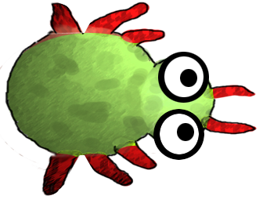
Return of the Greeps
CS18010
Team Members:
Tomos Fearn
Kamil Cupial
Ashley Evans
Sorres Arslan

Slide 2
What we are going to cover:
GitHub, what it is, how it works, how you found using it
GreenFoot, what it is
Greeps, the modifications you made, the experience had
Demo of greeps
The experience of working in a group

Slide 3

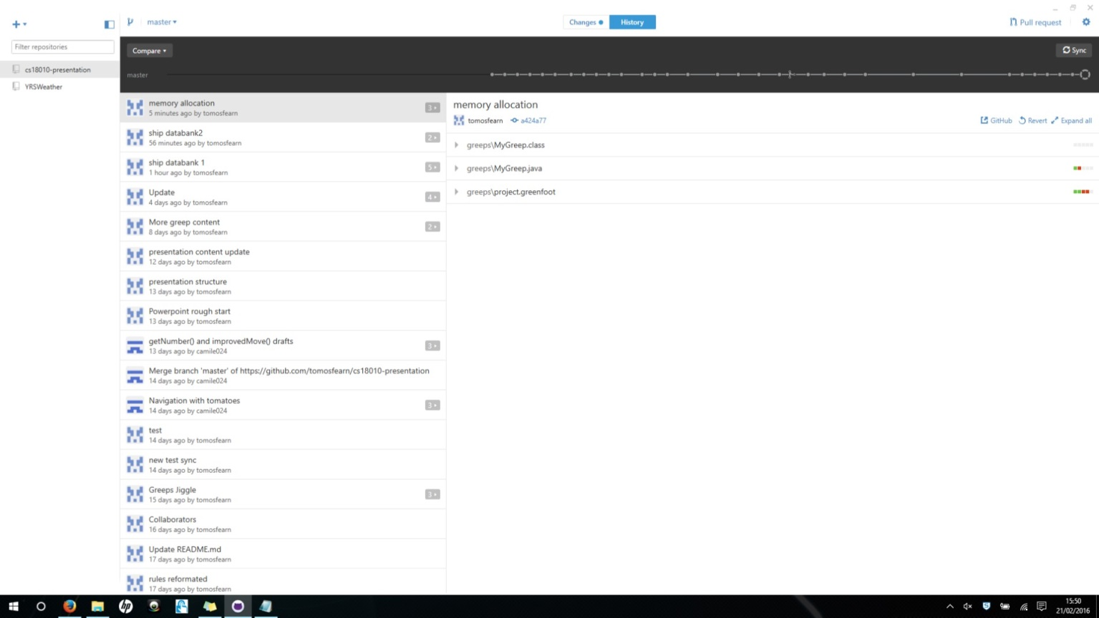
GitHub – What is it?
A
GitHub is a web based repository service
Designed for team projects
Free (Well mostly)
12 Million Active Users

Slide 4
How does it work?
A
I have no idea what to write here
I'm thinking about saying about forking, committing and pull requests

Slide 5
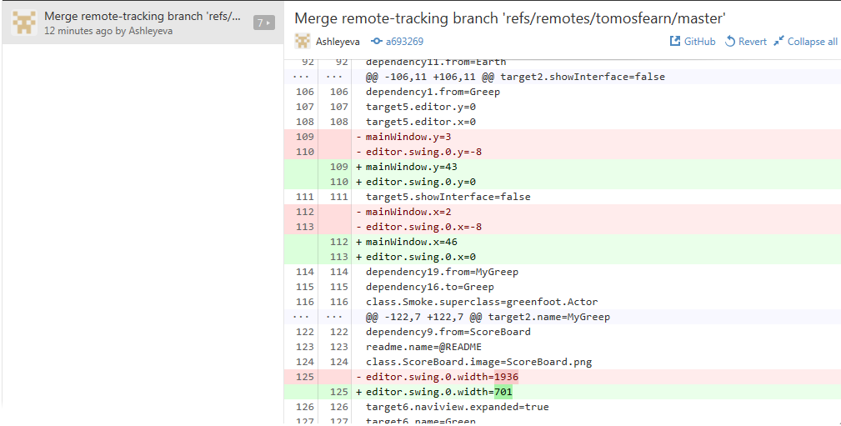
Our experience of GitHub
A
Good as long as you are careful
Provides lots of useful features such as:
Keeping track of changes
Shows exactly what changes have been made in code
Allows for version management

Slide 6

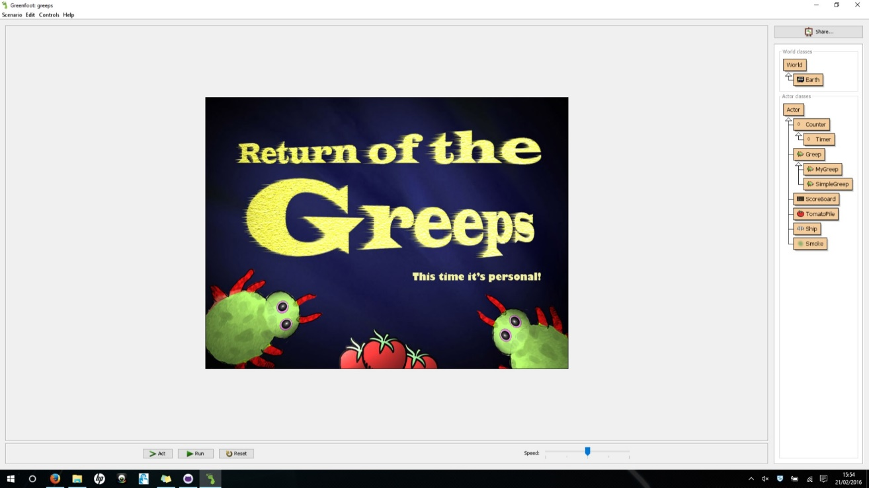
GreenFoot
S
GreenFoot is a Java IDE primarily designed for educational purposes
Developed at the University of Kent
Available for Windows, OS X, Linux (Free)
Designed to be simple and easy to use

Slide 7
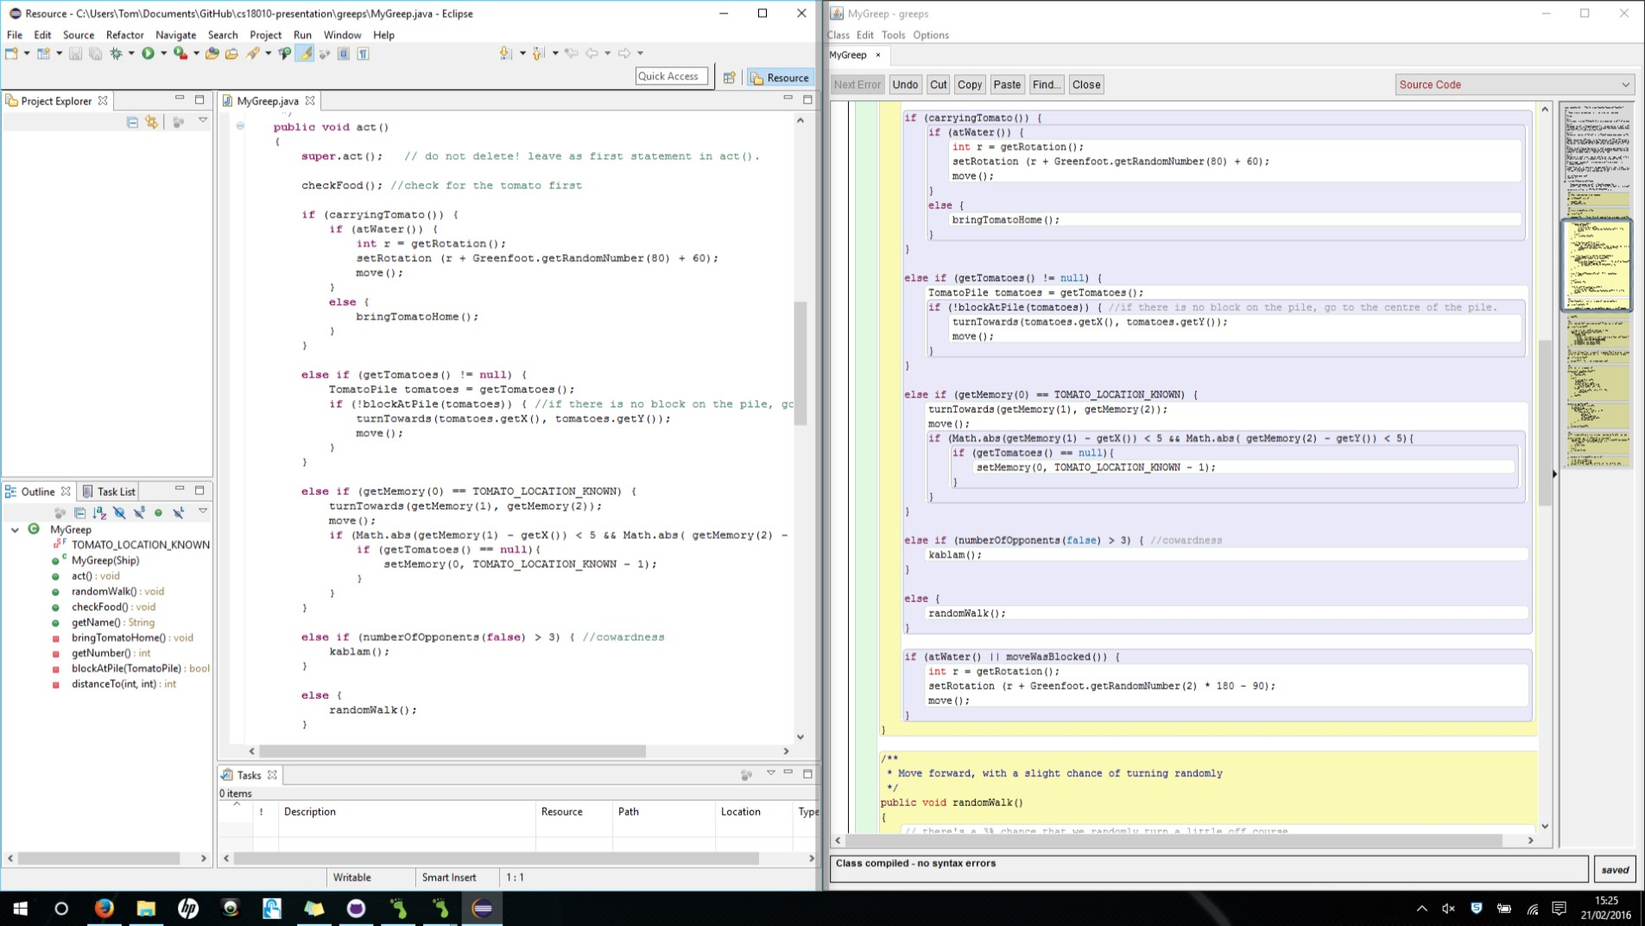

Our experience of GreenFoot
T
Difficult to find objects
Debugging can be unhelpful
Hard to read

Slide 8
Evolution of our Greeps…
T
What are the modifications we have made to the Greeps?
The experience we’ve had doing it.

Slide 9
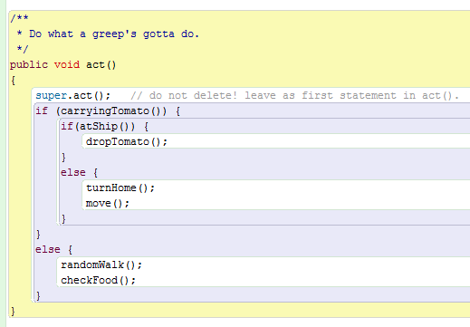
Our Basic Structure
Greeps are born very stupid and understand very little…
3 basic situations
If the Greep is carrying a tomato then run turnHome() and move().
If the Greep has arrived at the ship (Home) then drop the tomato.
Else wonder about looking for tomatoes.

Slide 10
Some basic features:
Panic attack!
If there are more than 3 enemy Greeps in range they explode with the method kablam()

Slide 11
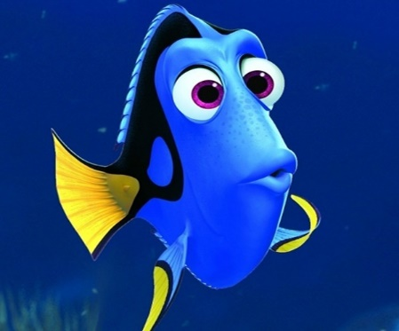
Our Main Problems
?
The memory of the Greeps were one of the biggest problems during the project
Problem:
Greeps can only remember 1 location at a time.
Solution:
Every time a Greep returns to the Ship it reads the memory bank from the ship where locations of the piles of tomatoes are known
Greeps are forgetful
?

Slide 12

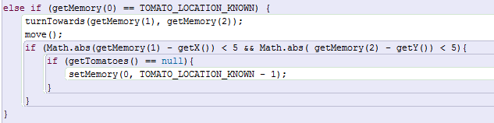
Our Main Problems
?
The invisible tomatoes
Problem:
Greeps return to the location where they found tomatoes and then stay there even when there are no tomatoes left.
Solution:
If the greep returns to its location where it knows the tomatoes are, but there are null tomatoes clear the memory and carry on randomWalk().
These tomatoes don’t have an invisibility cloak, the Greeps just return to the location and get stuck where they last found a tomato even when there are none left in the location.

Slide 13
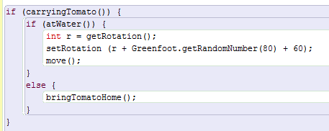
Our Main Problems
Water is an obstacle. Engage the Greep Jiggle!
Problem:
As our Greeps were on their way back to the ship they would get stuck at the water.
Solution:
We make the Greeps Jiggle their way around the water obstacle.
Our Greeps dance out of trouble…

Slide 14
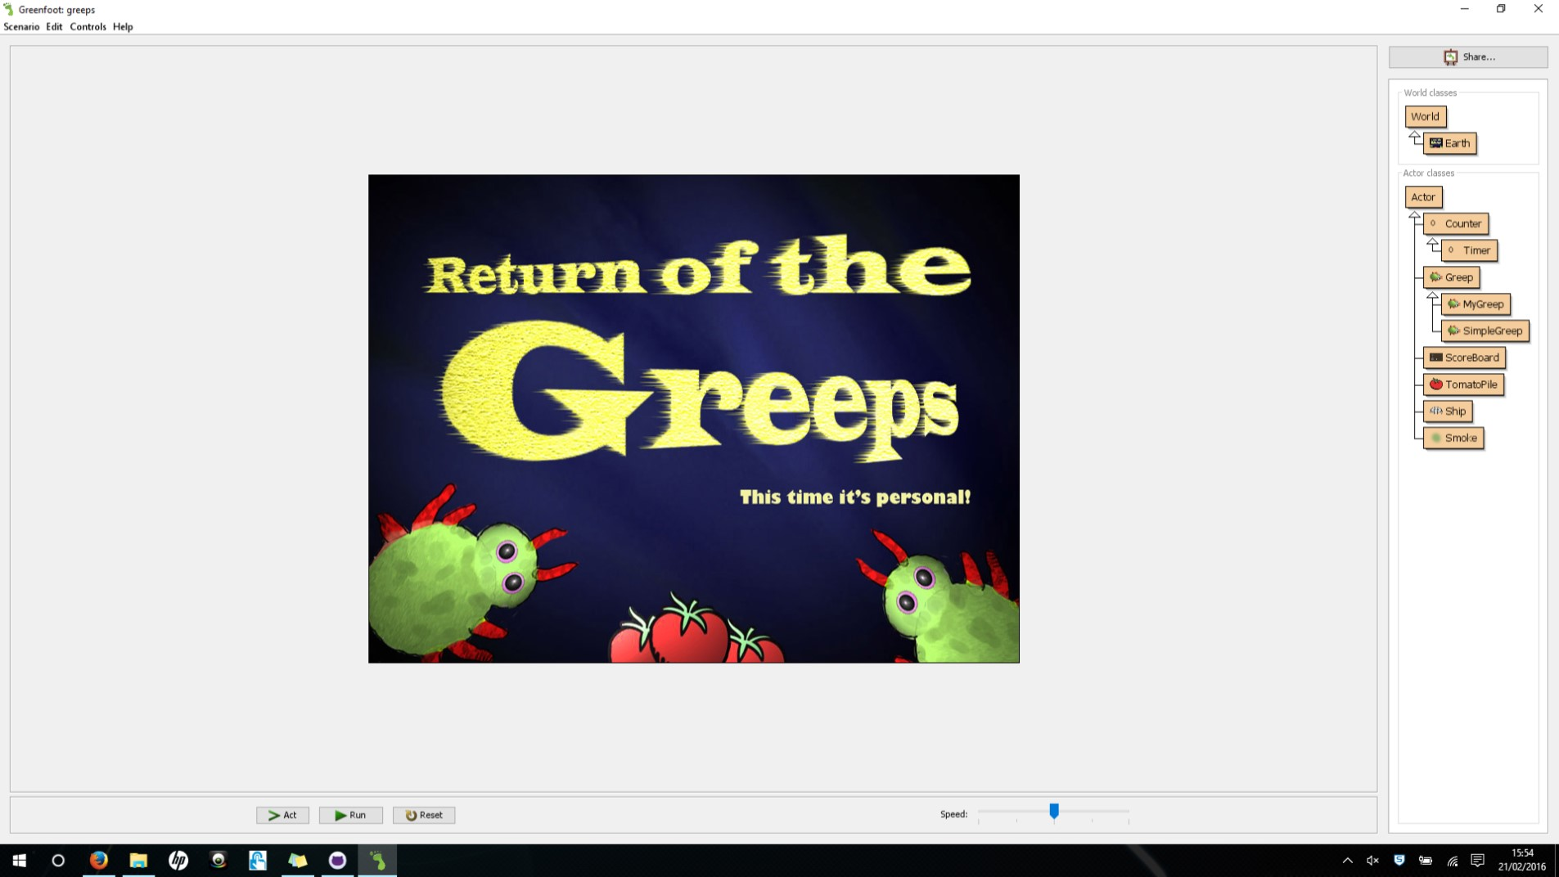
The Demo
Our Demo!

Slide 15
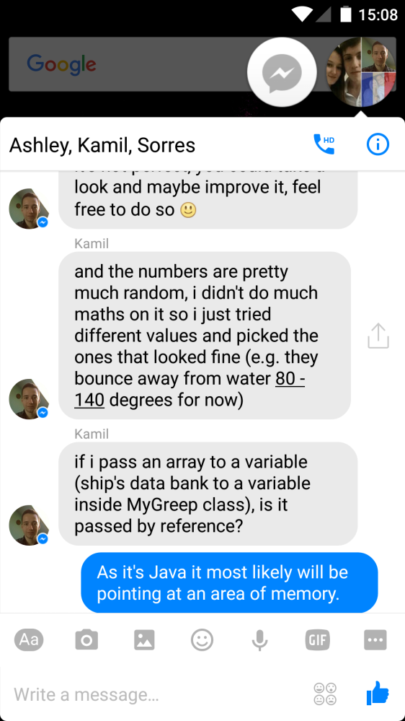
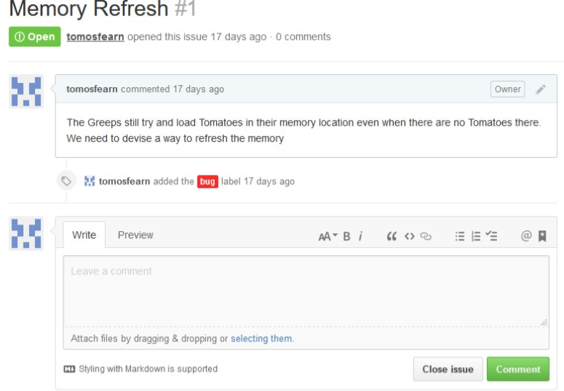
Our Teamwork
Facebook Messenger
GitHub Debug

